Slide 1

Synthetic image data generation
Authors:
Yoav Rozov

Slide 2

Introduction to Object Detection

Slide 3
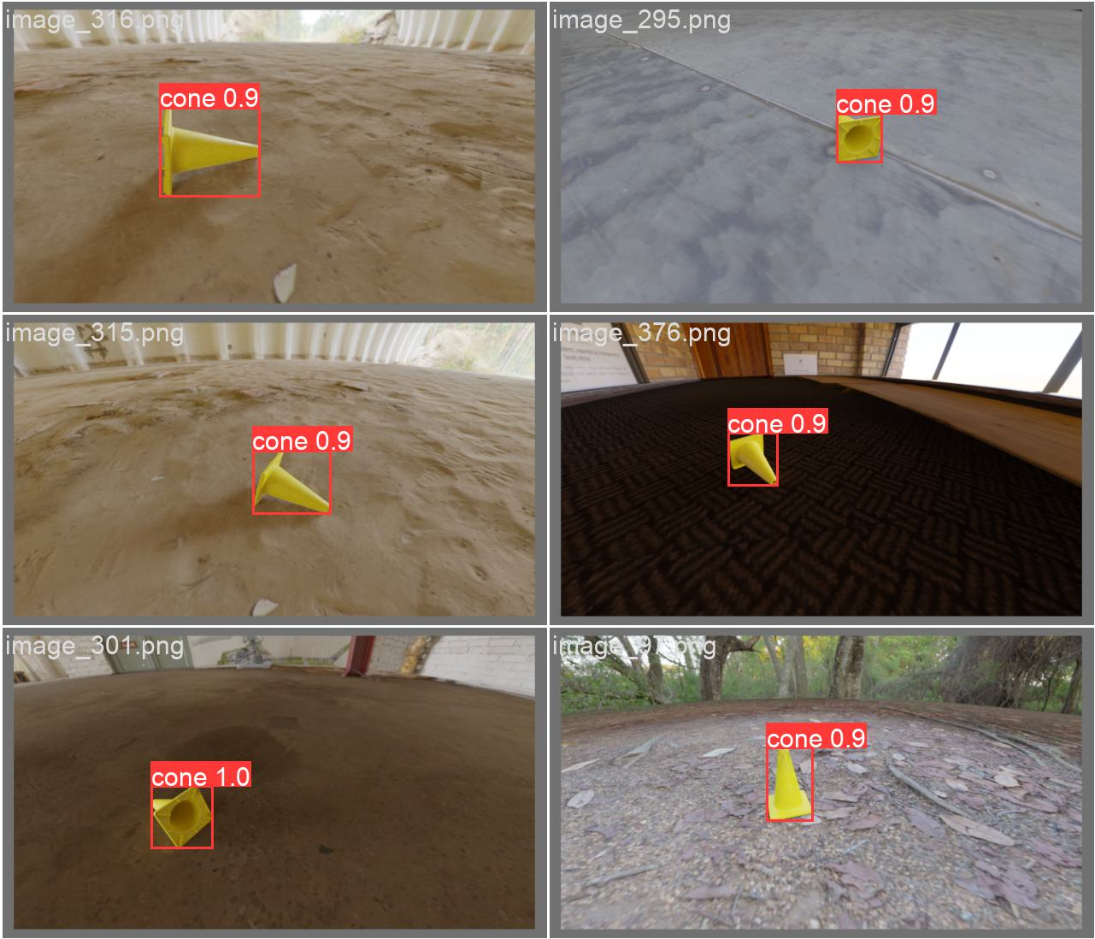
What is Object Detection?​
Definition of Object Detection​
Object detection identifies and locates objects within images or videos using bounding boxes
Beyond Image Classification​
It not only classifies objects but also determines their precise positions in real-time
FRC Application​
Used in robotics competitions to detect game pieces and obstacles for autonomous decision-making
Real-time Interaction​
Enables intelligent systems to interact with their environment dynamically and effectively

Slide 4
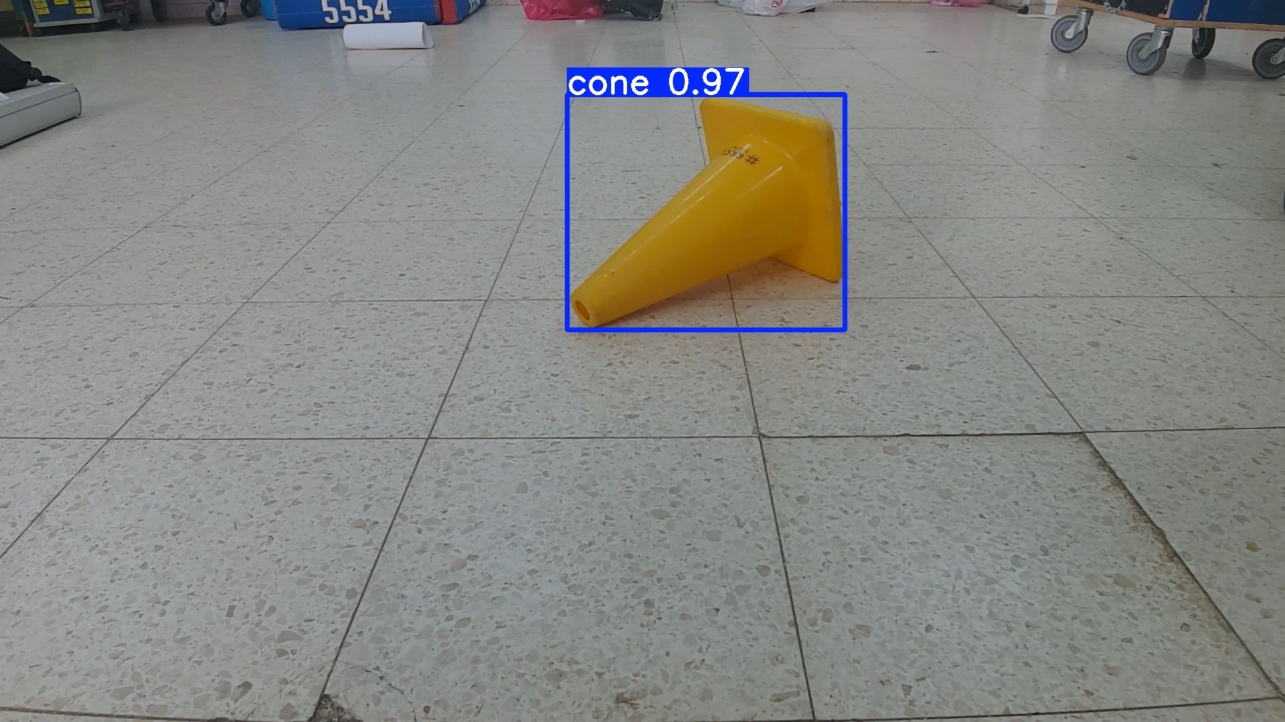
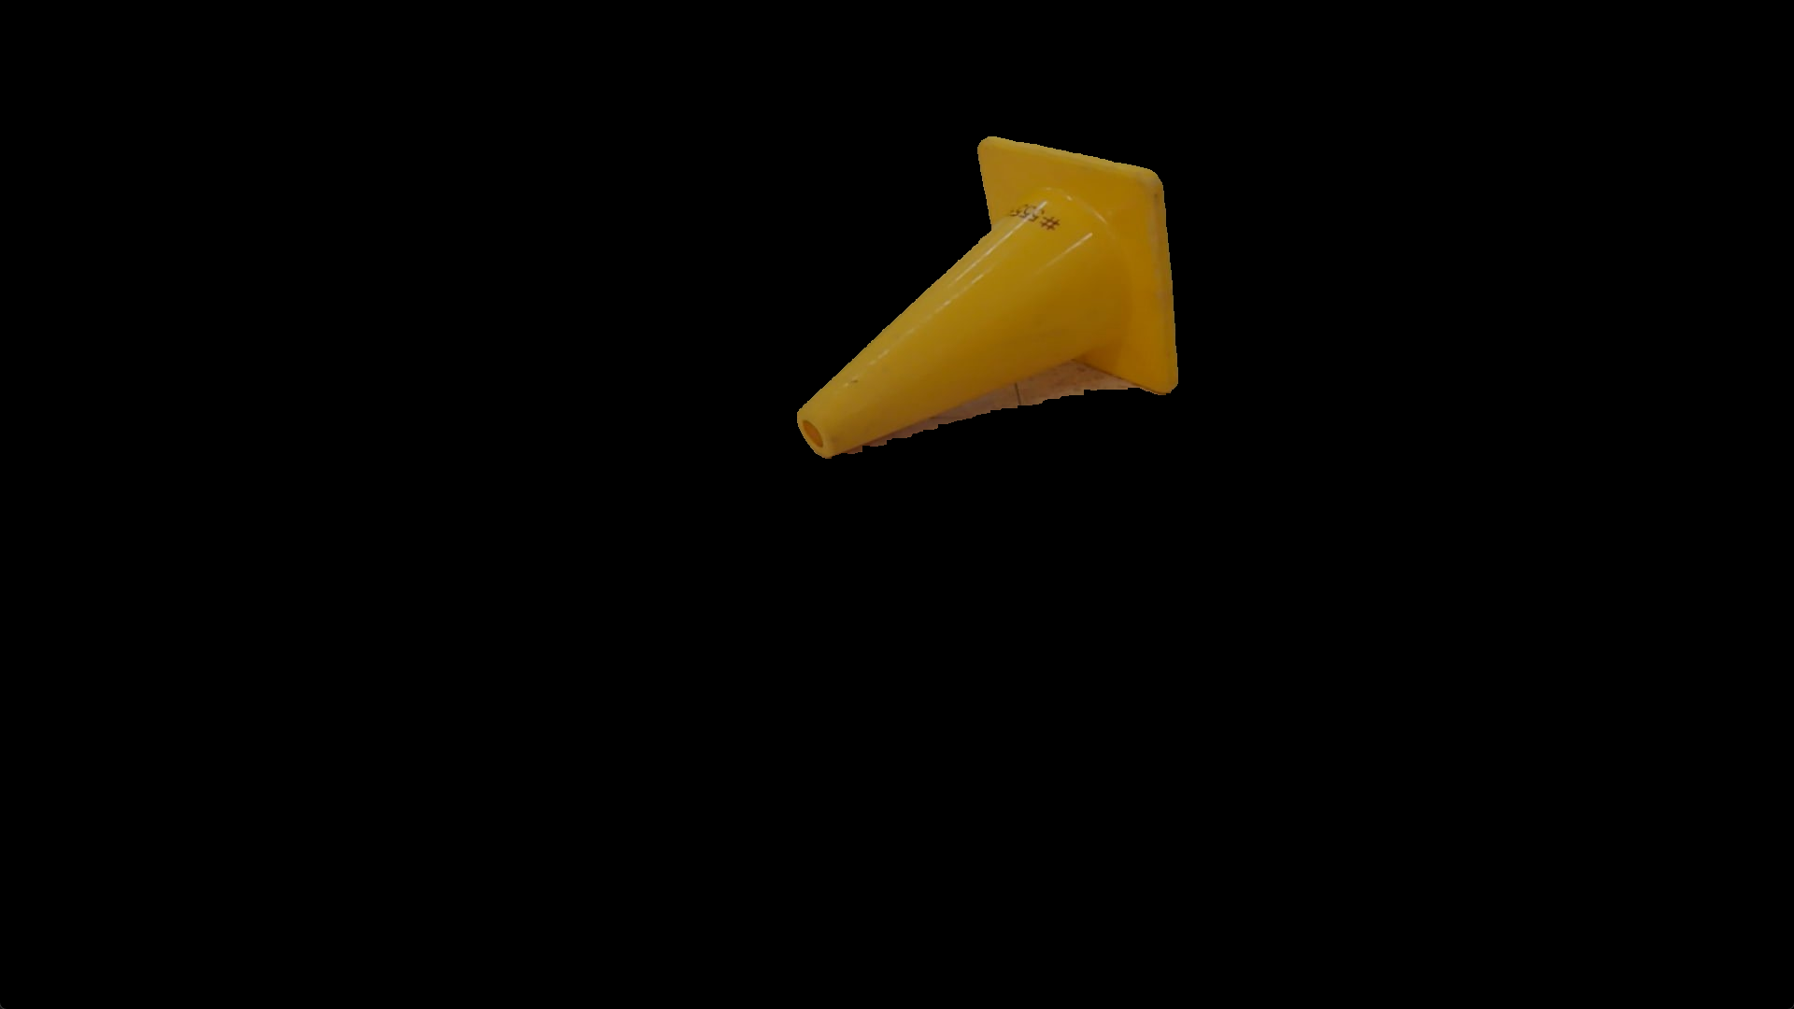

ML Detection vs Color Detection
Advantages of ML Detection
ML detection adapts to complex environments and when done correctly offers robust and accurate detection even in edge cases
Challenges of Color Detection
Color detection is fast but struggles with lighting changes and similar color backgrounds and edge cases
Resource and Scalability Factors
ML requires large datasets and computing power, while color detection suits more basic,
low-resource tasks

Slide 5

Synthetic Image Data

Slide 6
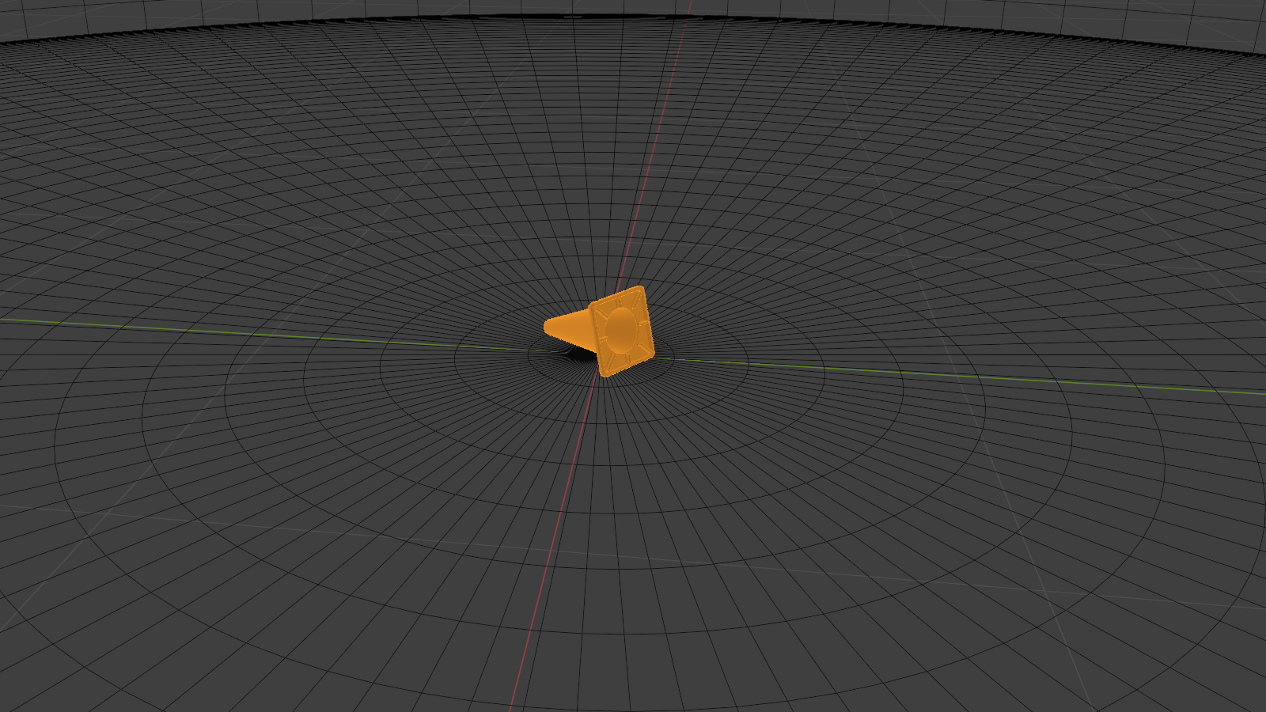
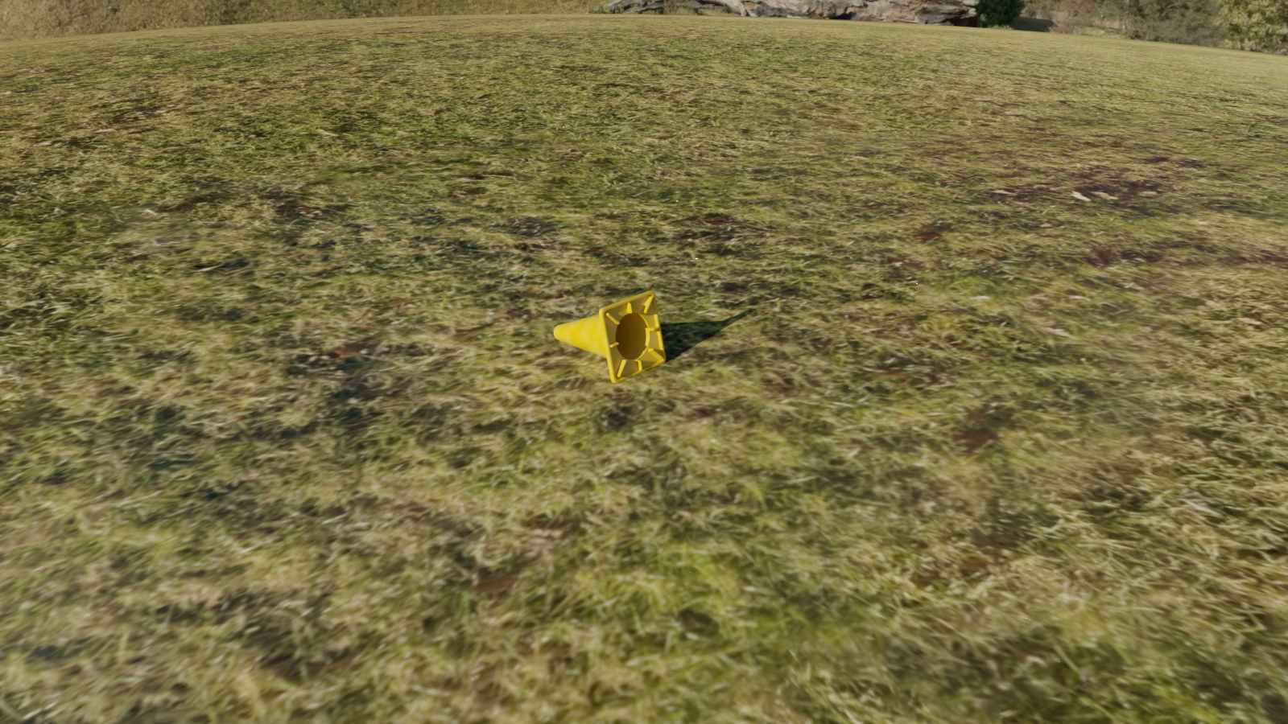
What is Synthetic Image Data?
Definition and Creation
Synthetic image data consist of artificially created images using 3D programs and tools, like Blender, for controlled environments and objects
Scalability and Efficiency
Synthetic data offers scalable and efficient dataset generation without manual collection or labeling of real Images
Use in Dynamic Scenarios
Synthetic data supports training models in scenarios with changing conditions where real data is scarce, inconsistent and hard to collect
Perfect Labeling Advantage
Synthetic images can be perfectly labeled, reducing huma error and enhancing model accuracy and performance

Slide 7
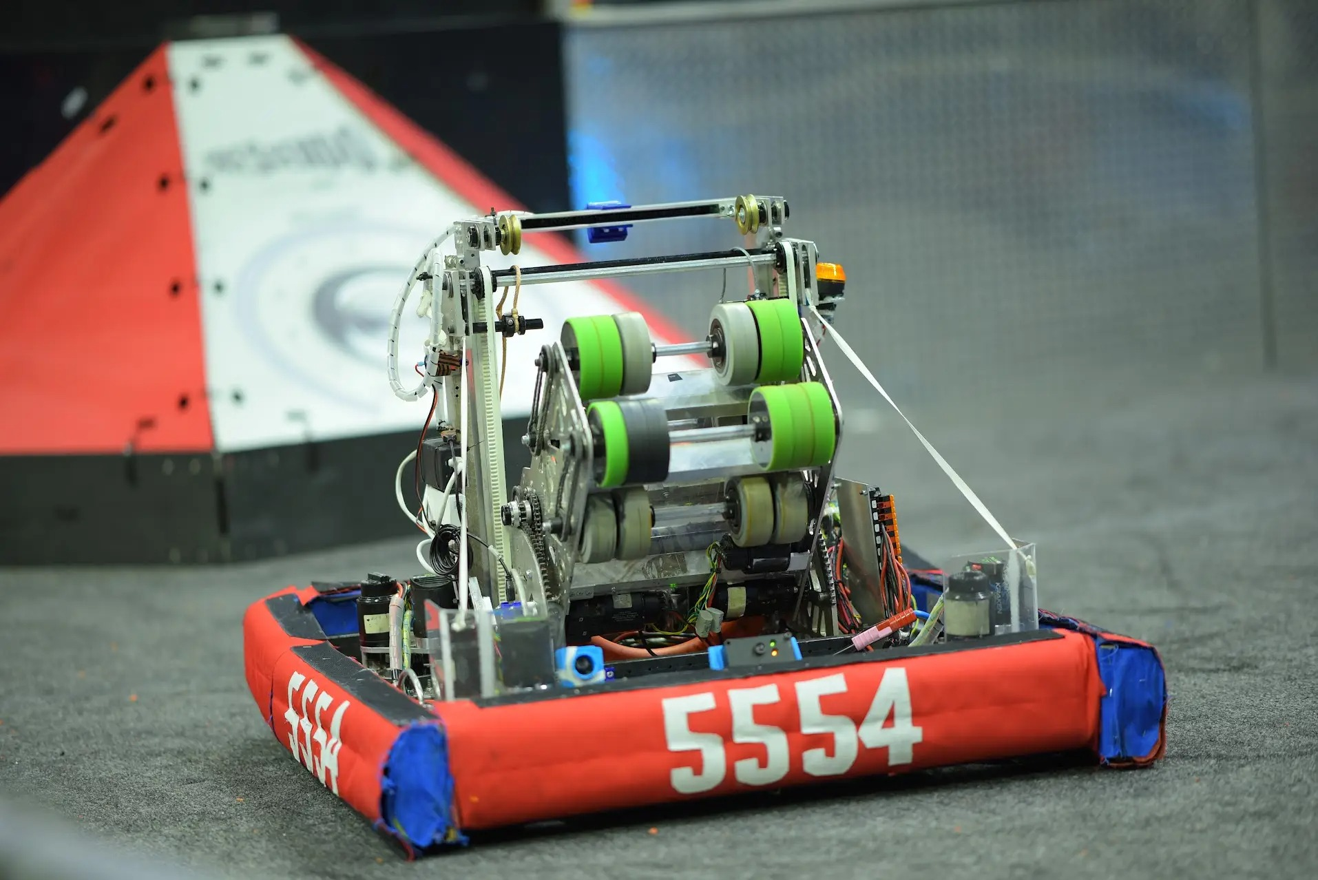
Why synthetic Data for FRC
Challenges of Real-World Data
Collection real-world data is very time consuming and requires manual setup, capturing, annotation and access to competition carpet and game objects
Flexibility of Synthetic Data
Synthetic data allows simulation of various scenarios without physical constraints or limitations
Early Model Training
Teams can begin training custom models early, even before the physical field and elements are available
Consistency and Accuracy
Synthetic data ensures consistent, accurate labeling that can be customized to work with a specific camera or Robot configuration.

Slide 8

Blender and Its Role

Slide 9
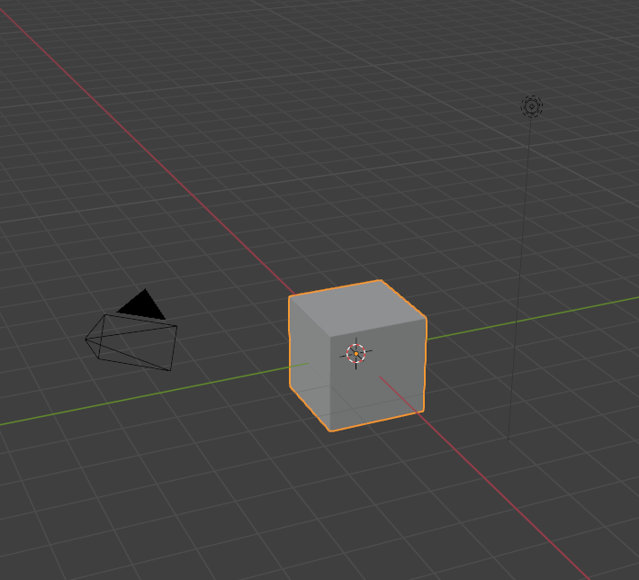
What Is Blender?
Comprehensive 3D Suite
Blender supports modeling, animation, rendering and simulation, making it a versatile 3D creation tool
Synthetic Data Generation
We can use Blender to create synthetic image data by modeling game pieces and simulating environments.
Automation via Scripting
Blender’s scripting automates rendering and creating large-scale datasets
Open Source and Free
Blender is completely open source and free. Blender supports many different 3D file formats which makes it very accessible and ideal for education and robotics applications like FRC
Notes:
https://www.blender.org/features/
https://www.blender.org

Slide 10

Workflow Overview

Slide 11
Workflow
3D Model Creation
Create or import 3D models of FRC game pieces into Blender, you can use the STL file format to transfer the model from SolidWorks to Blender. Keep in mind that Blender uses meters and SolidWorks uses millimeters, so we need to scale the object down after the import is complete
Material and Texturing
Using the “Shading” tab, configure the object’s material to be as realistic as possible
Scene Randomization
Using an automated script, randomize camera position, lighting and background at the beginning of each frame in the animation
Rendering
Use Blender’s cycles rendering engine to produce images and a masks that will later be used to accurately annotate the dataset
Annotate the dataset
Using python and OpenCV annotate each image using it’s mask and save the results

Slide 12

Python Notebook &
Source Code

Slide 13
Source material & python notebook
After this presentation
You should have a basic understanding of the overall concept.
The rest of the lesson will continue in the Python Notebook and Blender.
Python Notebook Includes:
Automation script for Blender
Code to generate annotations in YOLOv11 object detection format
Code to convert Blender images to grayscale (force the model to depend less on color data)
Code to train the YOLOv11 oAbject detection model
Code to use the trained model
Blender File Includes:
A basic environment and the Coral game piece (FRC 2025)
The automation script
Install Blender
Download from www.blender.org/download/ and follow the installation steps

